Slide 1

Infosys Springboard 5.0 Project
Predicting Obesity Levels
Using
Machine Learning & Deep Learning methods
Project Guide:
Narendra Kumar
Date:
November 2024

Slide 2

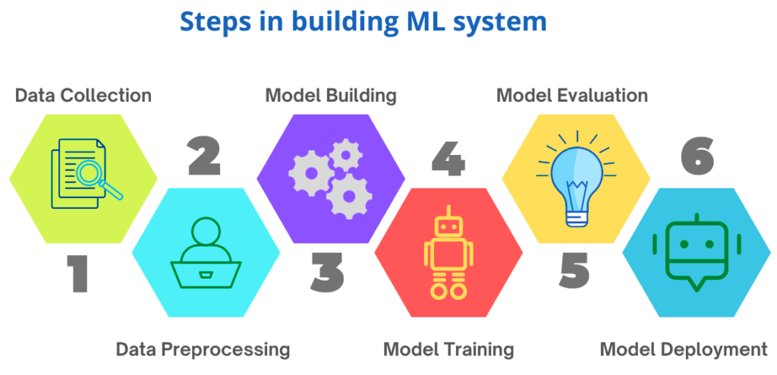
1
Steps:

Slide 3
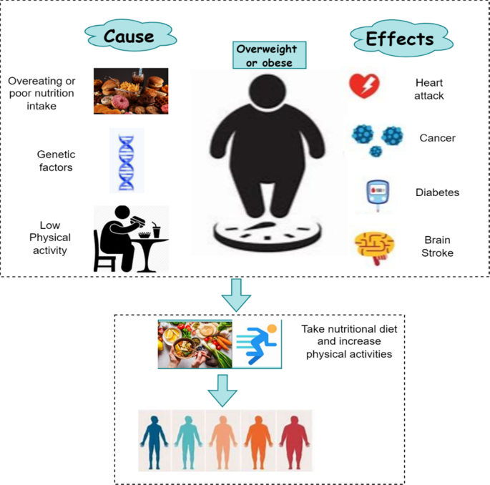
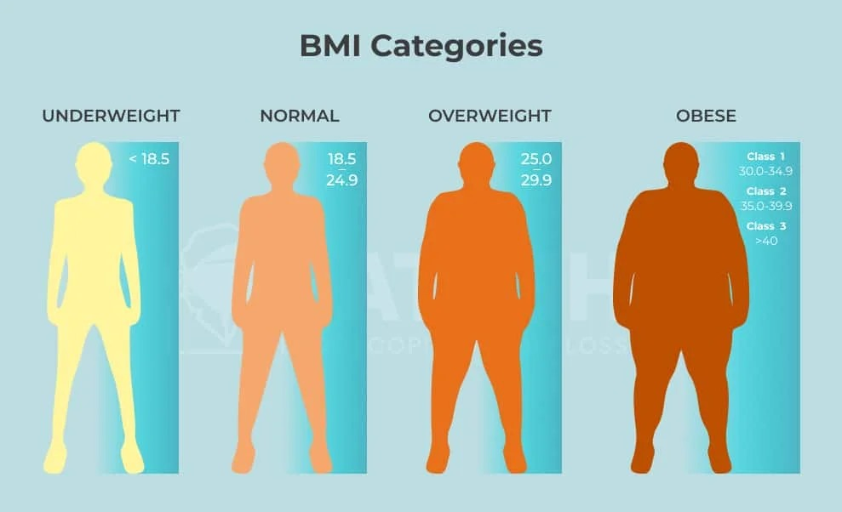
Project Aim:
To develop a predictive model assessing obesity levels using ML and DL, based on eating habits
and physical conditions.
Outcome:
Classify Obesity levels(insufficient weight,
normal weight, over weight types, obesity types)
2

Slide 4
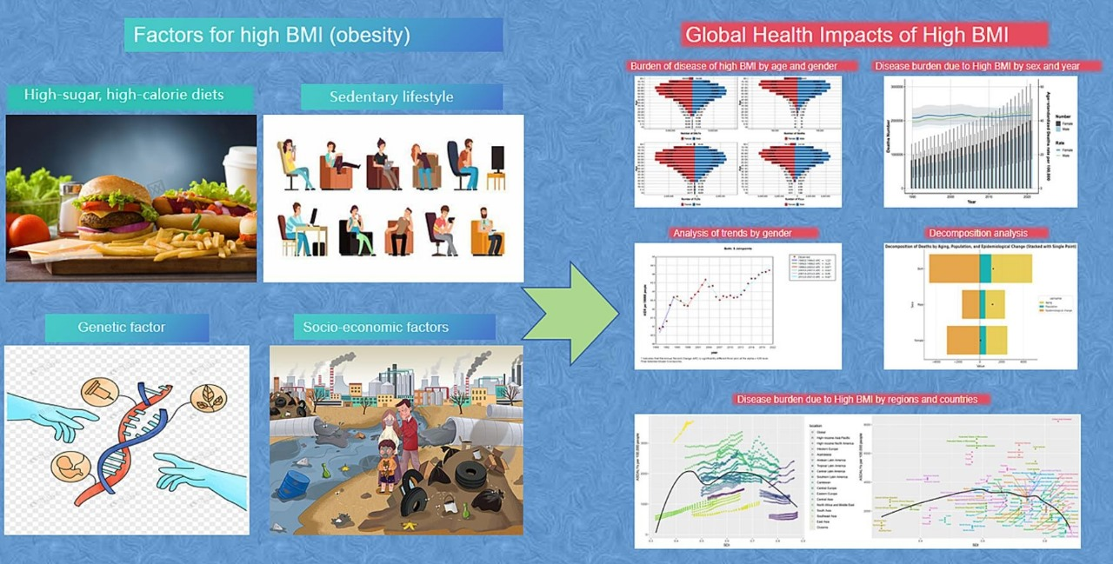
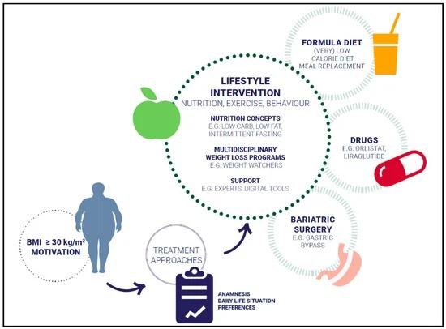
3
Problem Statement:
Objective:
Analyze eating habits and physical conditions for
accurate obesity prediction using data-driven models.
The Obesity Levels Prediction project analyzes eating habits and physical conditions to predict obesity levels, enabling early intervention.

Slide 5
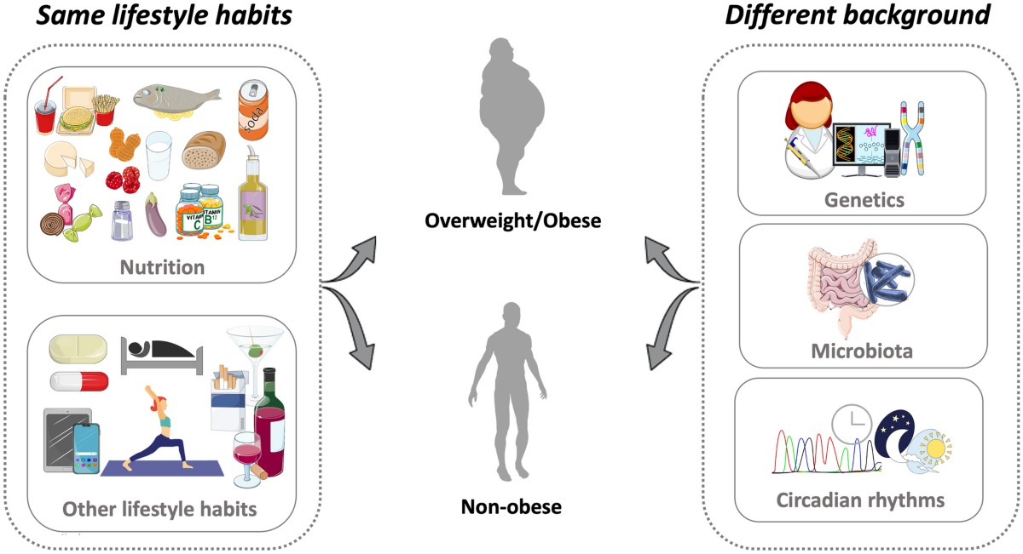
Dataset Overview
Source: Kaggle (Contributed by Lesumit Kumar Roy)
Features: 16 attributes covering eating habits, physical conditions and one more attribute which is
the target variable representing the Obesity level.
Key Attributes
4
Eating Habits:
High caloric food, vegetable consumption,
main meals, food between meals,
water intake, alcohol consumption.
Physical Conditions:
Calorie monitoring, physical activity,
technology usage, transportation.
Anthropometric Measurements:
Gender, height, weight.
Target Variable:
Obesity Levels.

Slide 6
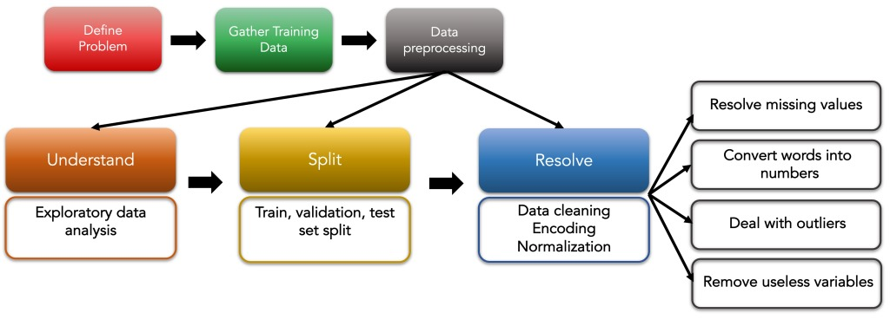
5
Exploratory Data Analysis (EDA)
Various visualizations were created to explore the data and understand the distribution of obesity levels: Data Exploration
Data Preprocessing
Data Cleaning
Data Encoding
Feature Engineering

Slide 7
6
Model Building:
Model | Description | Test Accuracy (7 Classes) | Test Accuracy (4 Classes) | Additional Notes
Logistic Regression | Multinomial logistic regression model built using processed dataset. | 85% | 85% | Confusion Matrix, classification report, and accuracy scores analyzed for evaluation.
K-Nearest Neighbors (KNN) | KNN classifier with varying neighbors; best accuracy achieved with 1 neighbor. | 84% | 82% | Plot showing accuracy based on number of neighbours generated.
Random Forest Classifier | Random forest model trained with max depth of 10. | 90.48% | 94% | Confusion Matrix, classification report, and accuracy scores analyzed for comparison.
XGBoost | XGBoost model trained with n_estimators of 100. | 90.63% | 99.81% | XGBoost is an algorithm resulting in improved model accuracy.
LightGBM | LightGBM is a fast, distributed, and high performance gradient boosting framework. | 90.54% | 95% | LightGBM is designed for efficient and scalable machine learning.
ANN | ANN model trained with less no.of layers. | 88.5% | 88% | ANNs learn and approximate any complex network.

Slide 8
7
Final Model Selection and Evaluation
After comparing the performance of Logistic Regression, KNN, Random Forest, XGBoost, LightGBM, and ANN models, XGBoost was selected due to its superior accuracy and higher precision in handling multi-class classification.
Web Application
User Choice:
The web application offers both 7-class and 4-class prediction options. Users can choose one, and the system will redirect them to the respective model.
Input:
Users provide details such as Gender, Height, Weight, FAVC, FCVC, NCP, CAEC, CH20, CALC, SSC, FAF, TUE, and MTRANS.
Prediction:
Based on the user’s choice, the application predicts obesity levels:
7 Classes Prediction: Insufficient Weight, Normal Weight, Overweight Level I, Overweight Level II, Obesity Type I, Obesity Type II, Obesity Type III.
4 Classes Prediction: Insufficient Weight, Normal Weight, Overweight, Obesity.

Slide 9
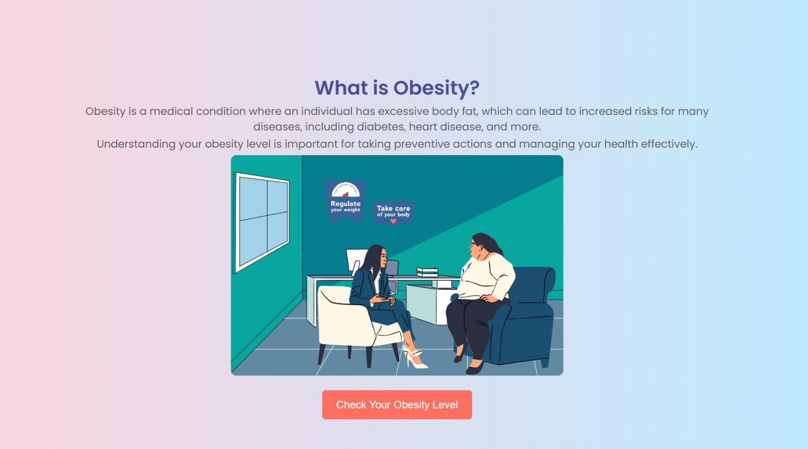
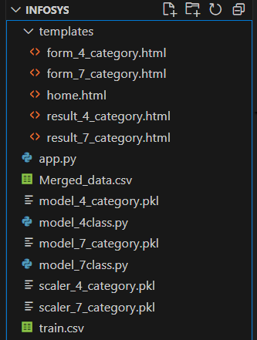
System Architecture
The web application is structured with a frontend developed using HTML5 and CSS for a responsive user interface, while the backend is built using Flask.
The XGBoost model is integrated into the backend, taking advantage of its scalability and performance for accurate predictions.
The application offers an user-friendly interface for entering the input data, with the predicted obesity level shown after the processing is completed.
8
Application
🔗 Application Demo Link
Home Page
Project Structure

Slide 10
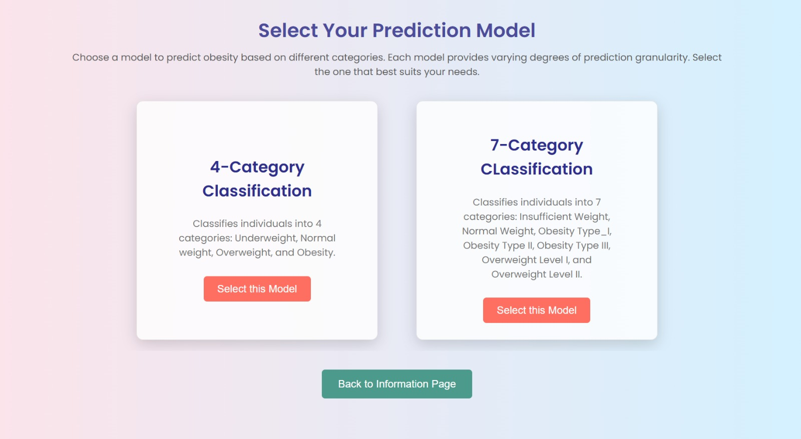
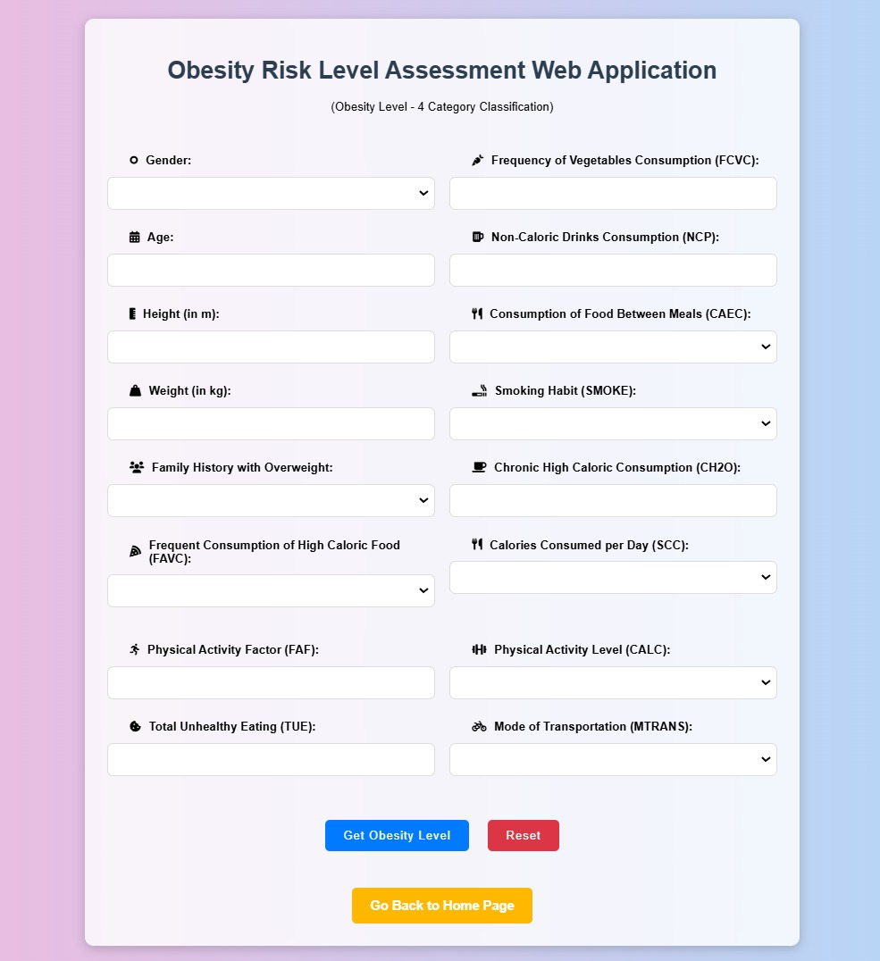
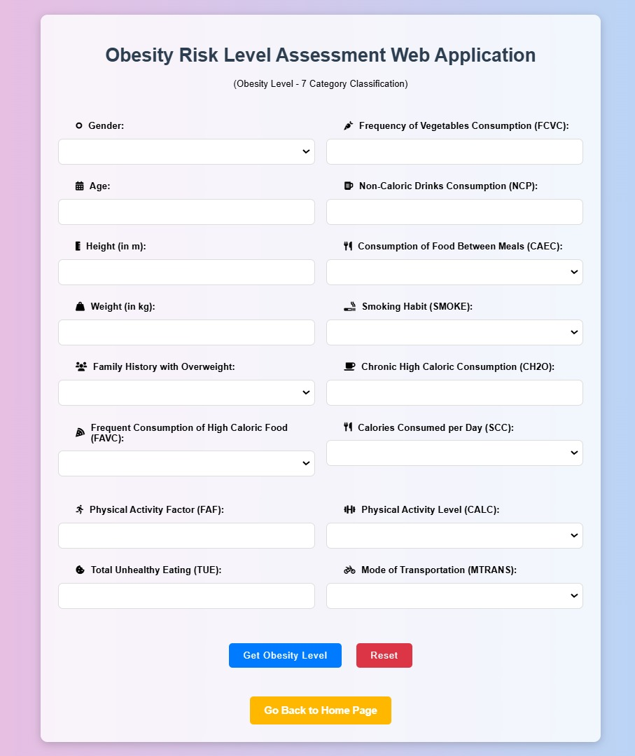
Model Selection Page
9
4 Category
7 Category

Slide 11
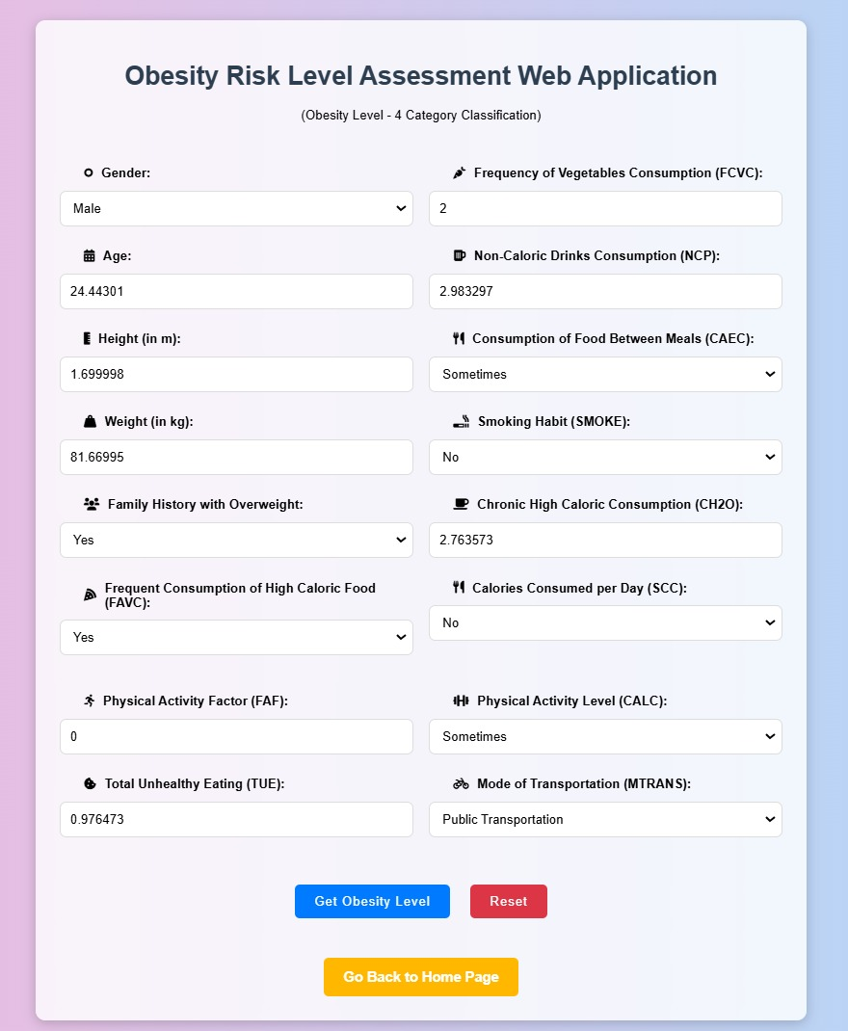
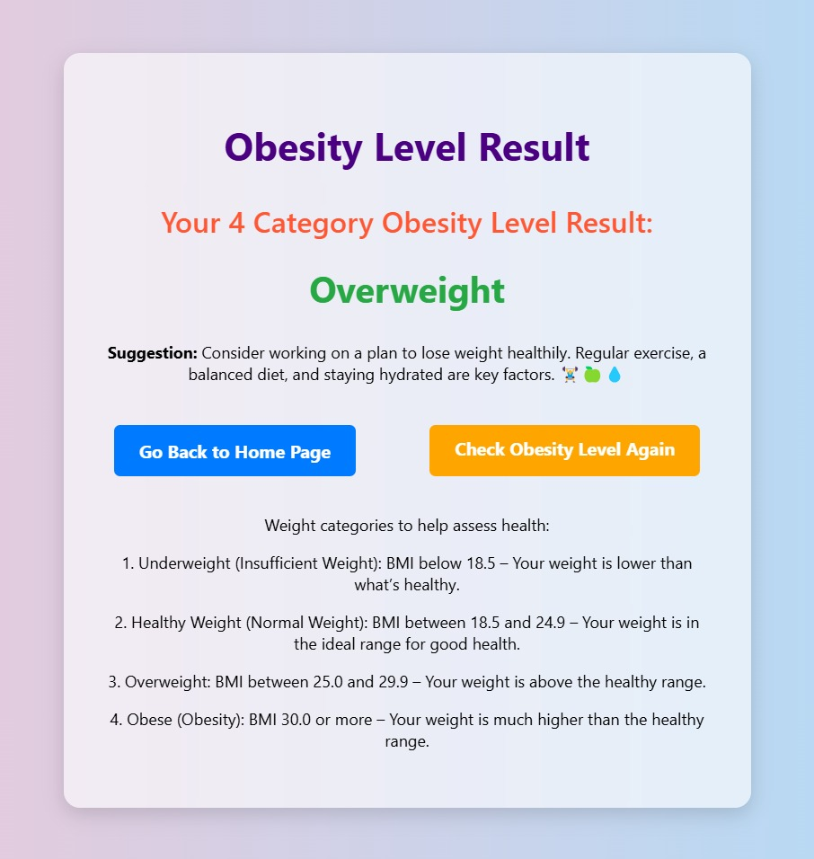
10
Input for 4 Category Obesity level Prediction
Output
Result (4 Category)

Slide 12
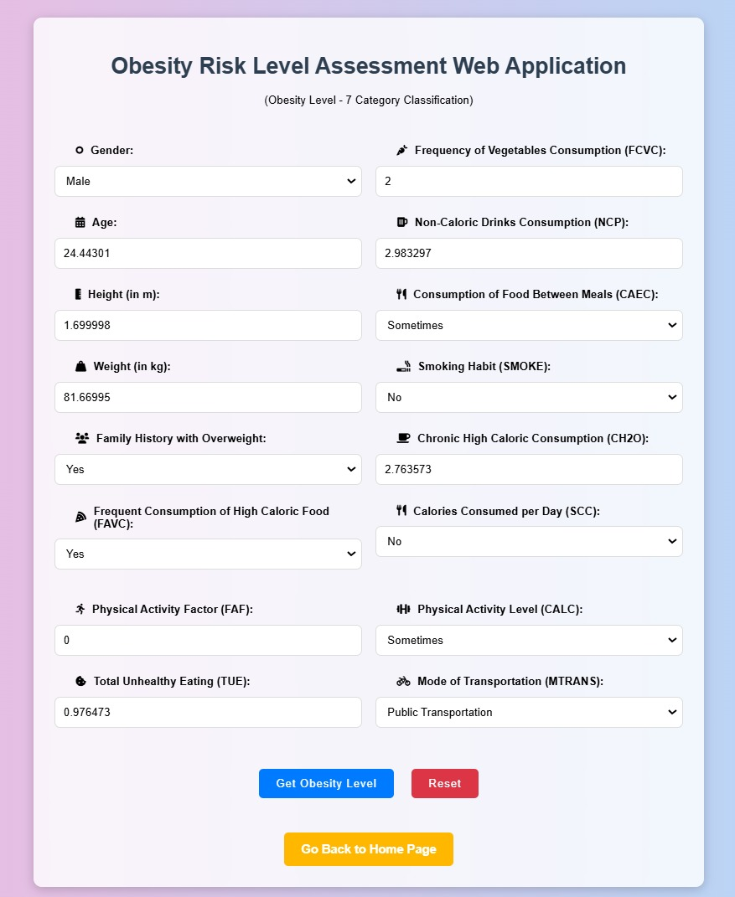
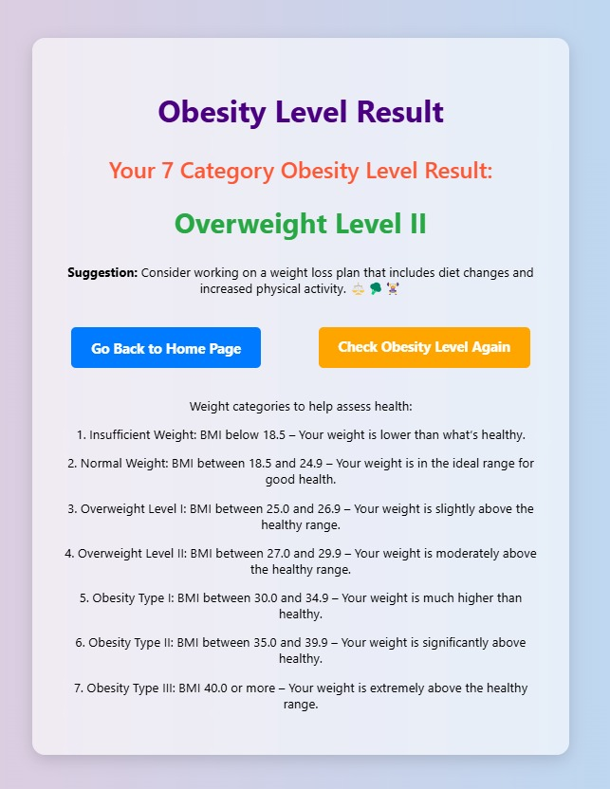
Input for 7 Category Obesity level Prediction
11
Output
Result (7 category)
Obstacles
Data Collection:
Difficulty in finding a large, comprehensive dataset.
Lack of suitable features in available datasets for accurate prediction.
Data Preprocessing:
Data entry errors impacted the reliability and trustworthiness of the data.
Noisy data affected the performance of the model.
Model Building:
Imbalanced datasets led to biased models.
Insufficient data quality compromised model accuracy.

Slide 13
Conclusion
The Obesity Level Prediction project shows how strong machine learning is in healthcare. Using the XGBoost algorithm, it predicts obesity levels very accurately. The web application reaches 90.63% accuracy for a 7-category model and 99.81% for a 4-category model. This is better than traditional methods. The interface is easy to use, helping people understand their obesity risk and make health decisions.
Future Work
Early Intervention & Prevention:
Focus on preventing obesity-related diseases through early detection and intervention.
Personalized Healthcare:
Develop personalized healthcare and wellness strategies based on user data.
Collaboration with Healthcare Professionals:
Work with healthcare experts to validate the model clinically.
Machine Learning in Healthcare:
Explore further integration of machine learning into healthcare decision-making processes.
Algorithm Exploration:
Investigate other machine learning algorithms to compare and improve model performance.
12
References:
Obesity Prediction Dataset
Obesity Data Set
Obesity Risk EDA & Prediction Dataset
Obesity Classification with Extra Trees (100% Accuracy)

Slide 14
THANK YOU

